Slide 1
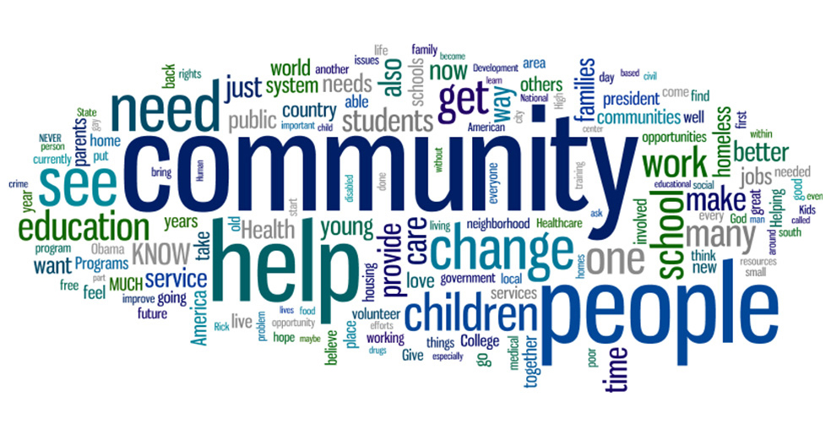
Ballarat Central
Uniting Church
Pentecost 3
Sunday 14th June 2026
“Responding in Community”

Slide 2

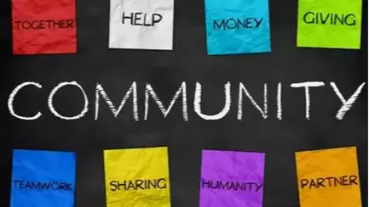
PROCLAMATION OF THE WORD!
Responding in Community!

Slide 3


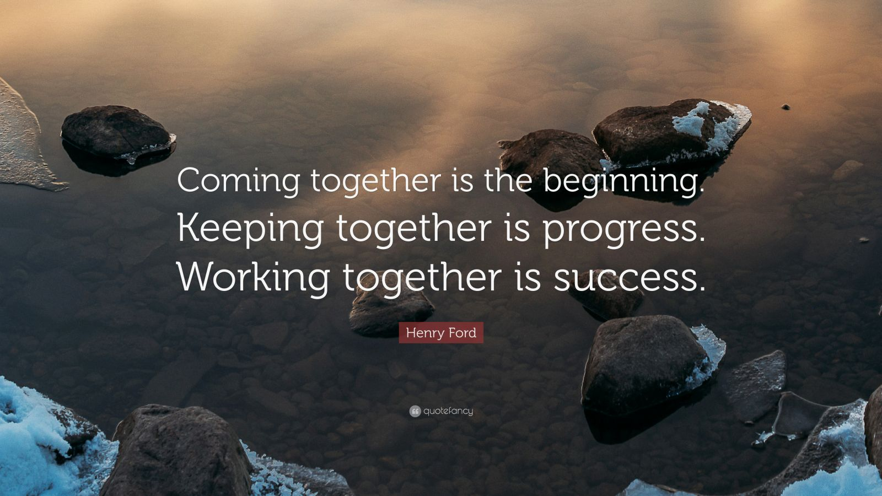

Aesop’s fable –
United States of America
“We are all in this together” in High School Musical Movie
Henry Ford - Founder of the Ford Motor Company
We are Uni”ting”
and not Uni“ted”.

Slide 4
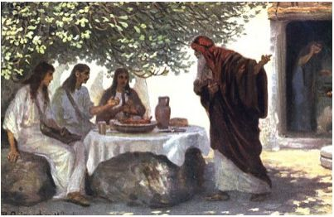
Abraham, Sarah, Servant - did it together!

Slide 5
⁶ And Abraham hastened into the tent to Sarah and said, “Make ready quickly three measures of choice flour, knead it, and make cakes.” ⁷ Abraham ran to the herd and took a calf, tender and good, and gave it to the servant, who hastened to prepare it. ⁸ Then he took curds and milk and the calf that he had prepared and set it before them, and he stood by them under the tree while they ate.

Slide 6
Hospitality - Responding in Community!

Slide 7
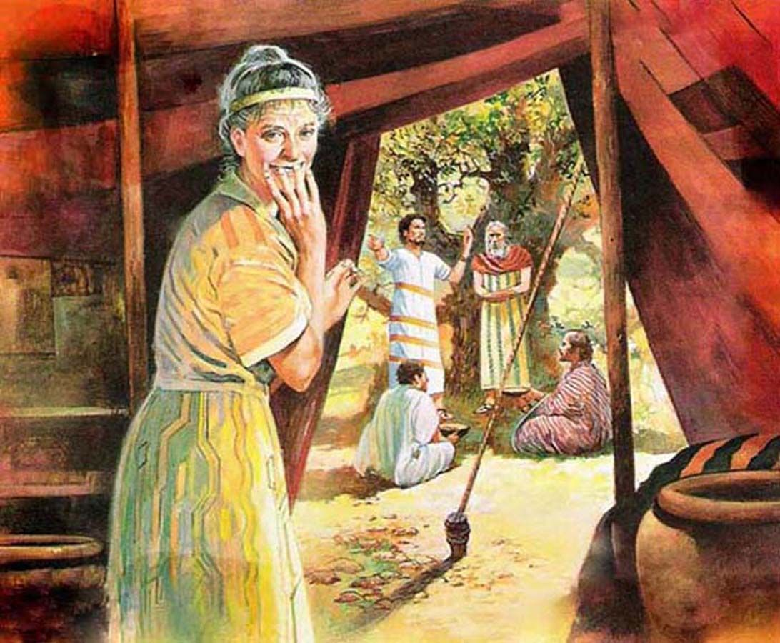
COMMUNITY – God, Abraham, Sarah, Visitors …
The Lord said to Abraham, “Why did Sarah laugh and say, ‘Shall I indeed bear a child, now that I am old?’ ¹⁴ Is anything too wonderful for the Lord?

Slide 8
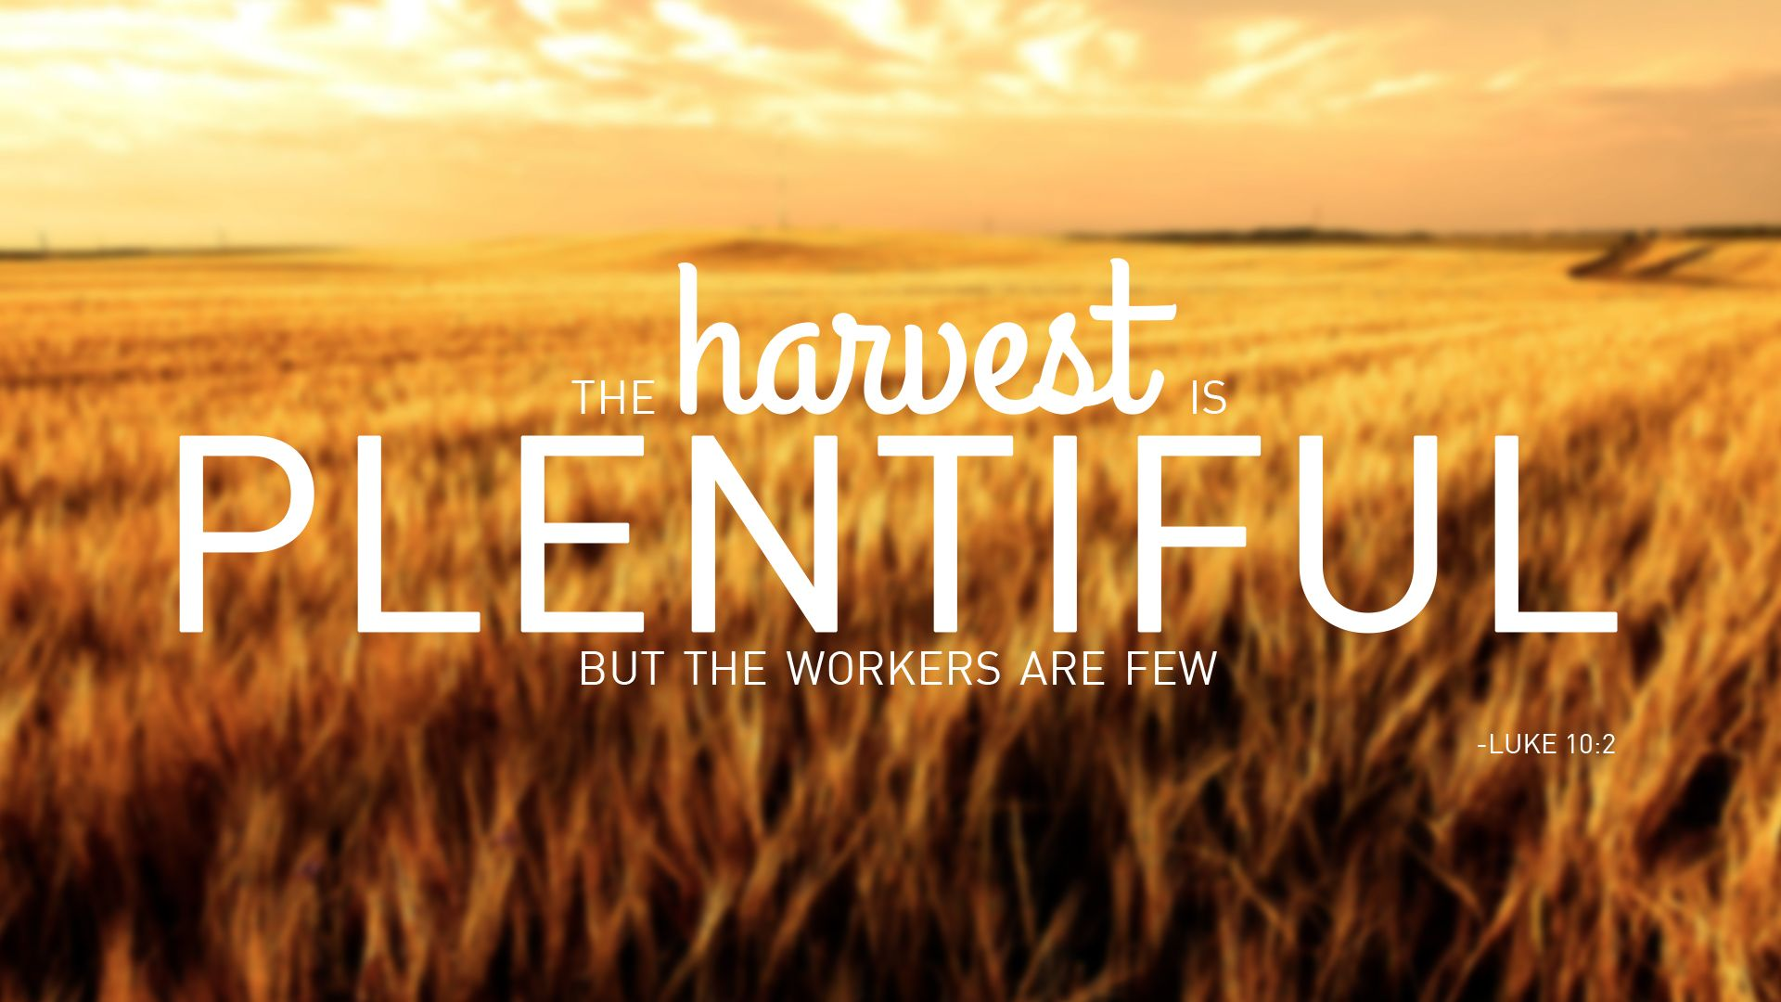

Slide 9
9 ³⁷ Then he said to his disciples, “The harvest is plentiful, but the laborers are few; ³⁸ therefore ask the Lord of the harvest to send out laborers into his harvest.”
The Twelve Apostles
10 ¹Then Jesus summoned his twelve disciples and gave them authority over unclean spirits, to cast them out, and to cure every disease and every sickness.

Slide 10
The Mission of the Twelve
⁵ These twelve Jesus sent out with the following instructions: “Do not take a road leading to gentiles, and do not enter a Samaritan town, ⁶ but go rather to the lost sheep of the house of Israel. ⁷ As you go, proclaim the good news, ‘The kingdom of heaven has come near.’

Slide 11
The mission of the Twelve
⁸ Cure the sick; raise the dead; cleanse those with a skin disease; cast out demons. You received without payment; give without payment.

Slide 12


Slide 13
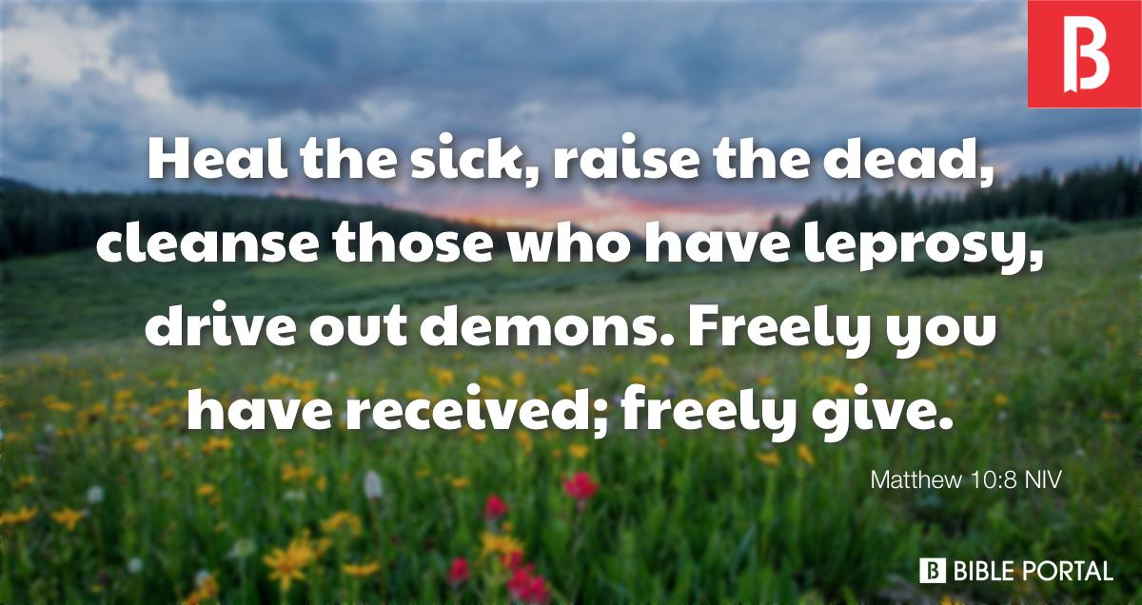
Responding in Community!

Slide 14

Let us respond as a Community!
Partnering other Communities!
“The harvest is plentiful, but the laborers are few.”
BCUC, we are God’s Community!

