Slide 1

Ballarat Central
Uniting Church
Pentecost 4
Sunday 21st June 2026
“ONE: In God and with One Another!”
49th Anniversary!

Slide 2
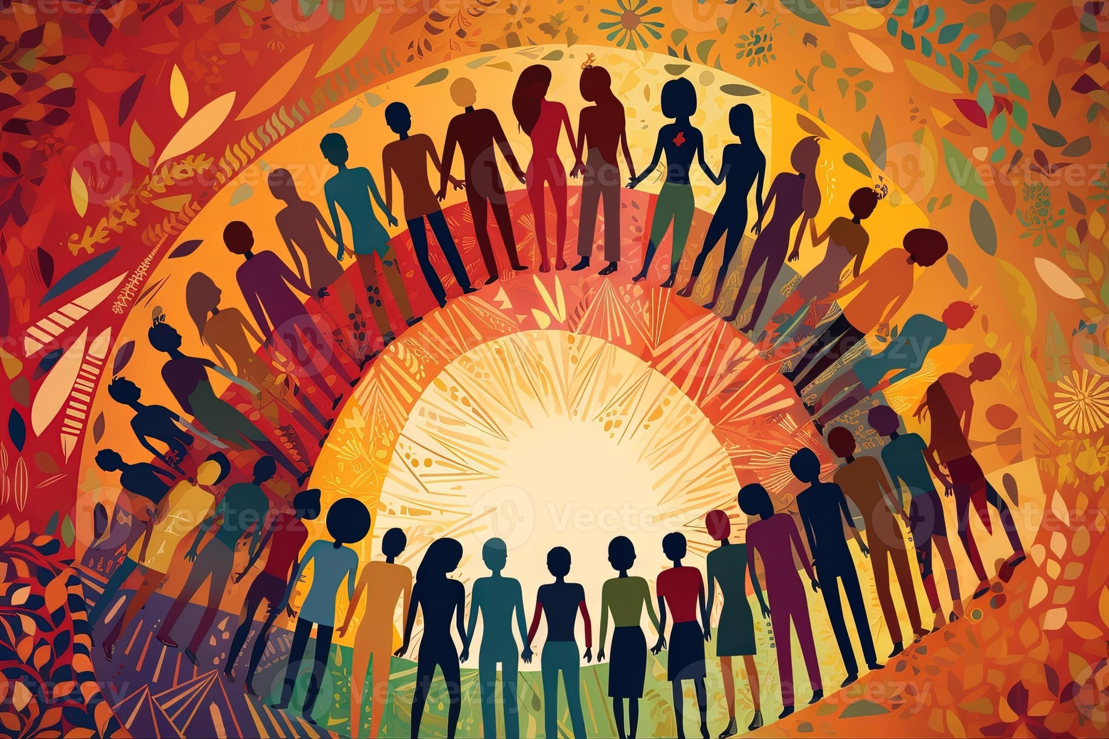
PROCLAMATION OF THE WORD!
“ONE: In God and With One Another!”

Slide 3
UCA 49th Anniversary!
“Uni-ting” … “In” …

Slide 4
What is human being?
Biological definition …
Social definition …
Cultural definition …
Racial definition …
Political definition …
Theological definition/perspective …

Slide 5
JOHN 17:20-21
²⁰ “I ask not only on behalf of these but also on behalf of those who believe in me through their word, ²¹ that they may all be one. As you, Father, are in me and I am in you, may they also be in us, so that the world may believe that you have sent me.

Slide 6
Creation Story
Genesis 1
²⁷ So God created humans in his image,
in the image of God he created them;
male and female he created them.
Human being (you/me) is Godly!

Slide 7
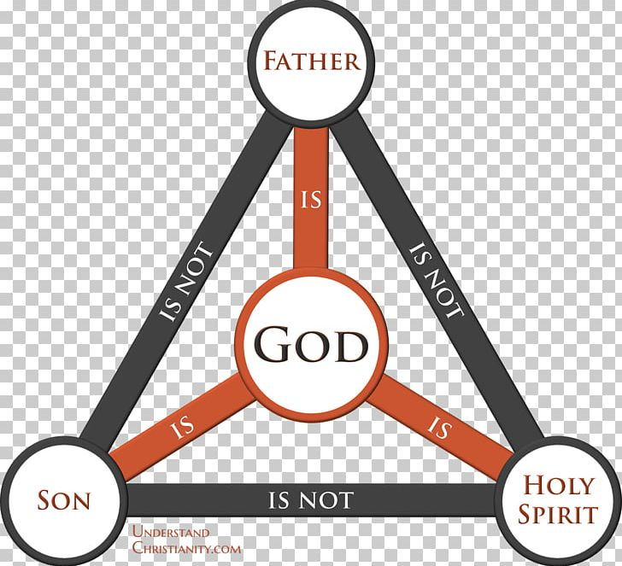
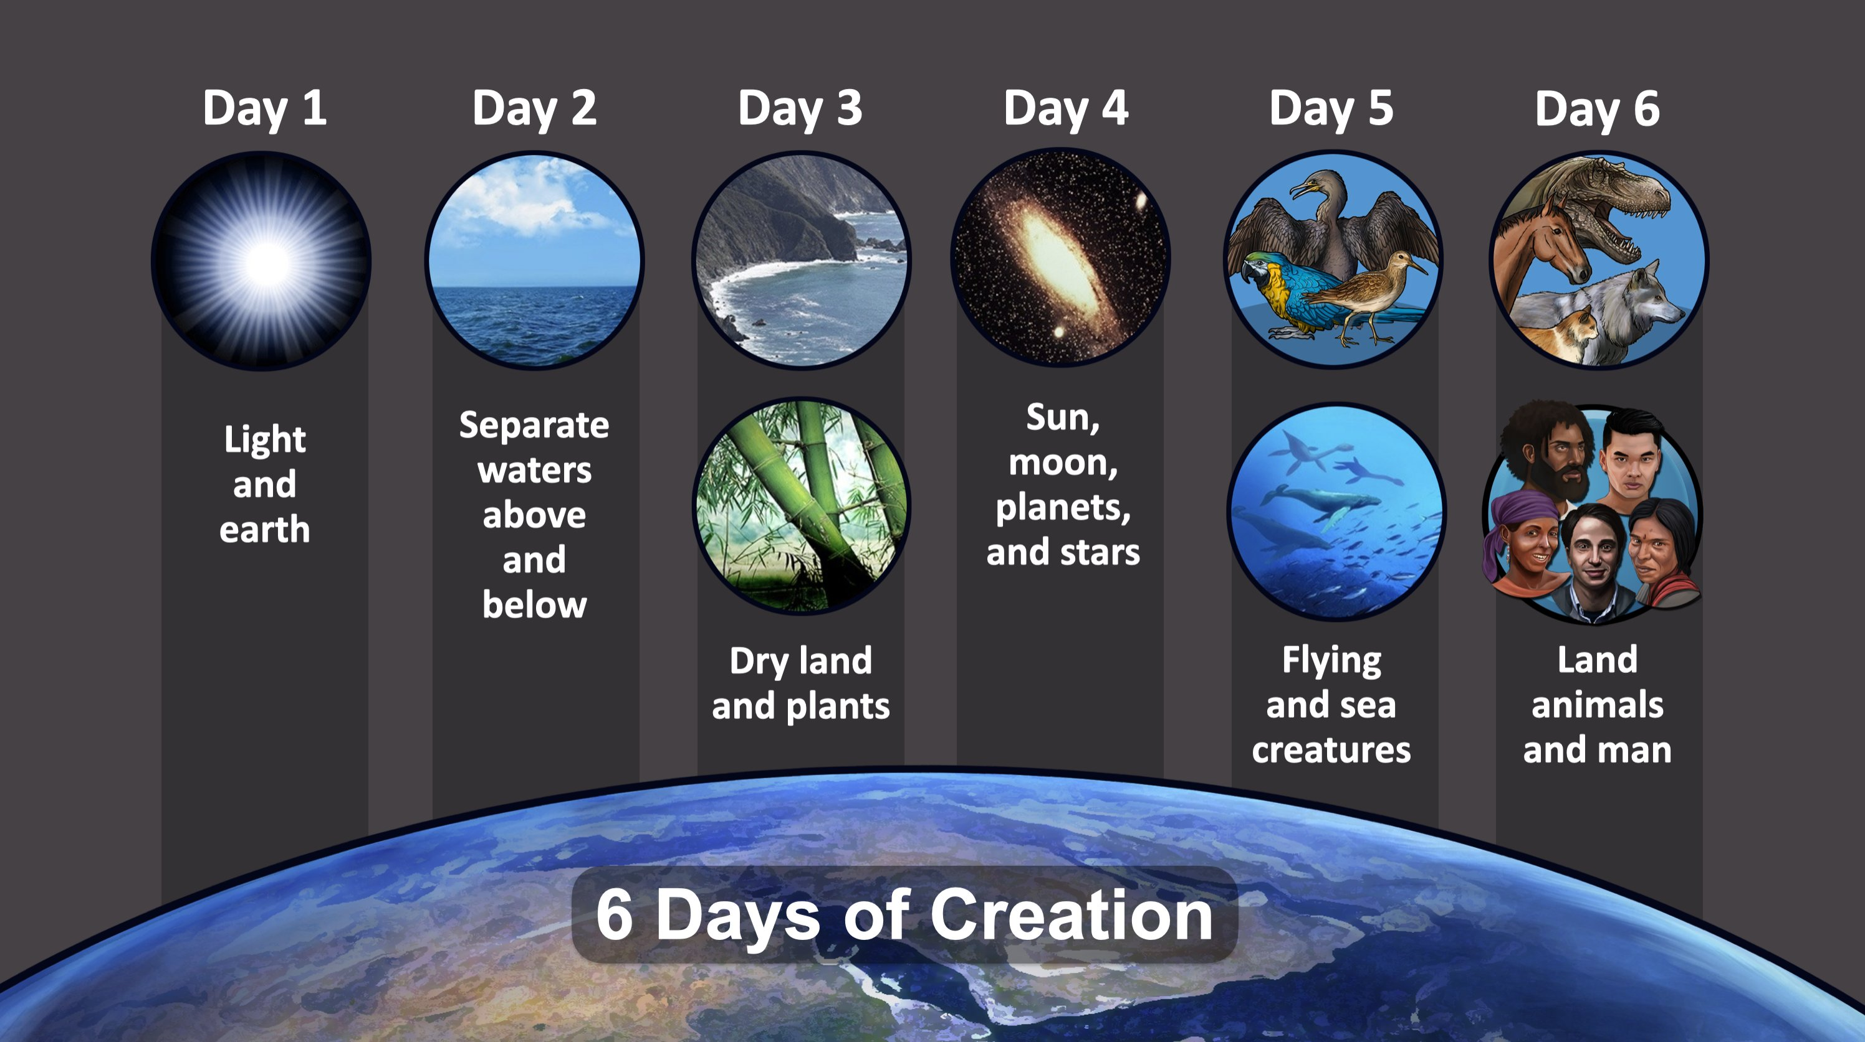
We are part of “God” and “Creation”!

Slide 8

Cultural diversity!
Racial diversity!
We are One (ourselves) In Jesus (God)!
Age Diversity!
Gender diversity …

Slide 9
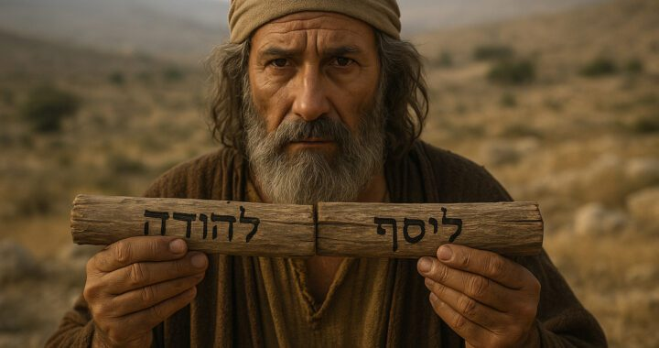
EZEKIEL – The Two Sticks Vision

Slide 10
EZEKIEL 37:15-19 - The Two Sticks
¹⁵ The word of the Lord came to me: ¹⁶ Mortal, take a stick and write on it, “For Judah and the Israelites associated with it”; then take another stick and write on it, “For Joseph (the stick of Ephraim) and all the house of Israel associated with it”; ¹⁷ and join them together into one stick, so that they may become one in your hand.

Slide 11
¹⁸ And when your people say to you, “Will you not show us what you mean by these?” ¹⁹ say to them, “Thus says the Lord God: I am about to take the stick of Joseph (which is in the hand of Ephraim) and the tribes of Israel associated with it, and I will put the stick of Judah upon it and make them one stick, in order that they may be one in my hand.”

Slide 12

Judah
Joseph

Slide 13
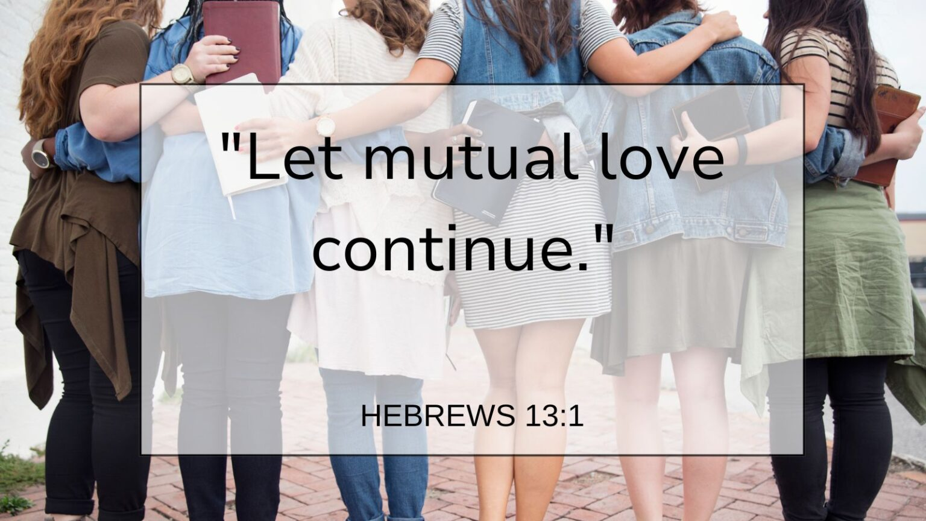

Slide 14
HEBREWS 13:1-3
Service Well-Pleasing to God
13 ¹Let mutual affection continue. ² Do not neglect to show hospitality to strangers, for by doing that some have entertained angels without knowing it. ³ Remember those who are in prison, as though you were in prison with them, those who are being tortured, as though you yourselves were being tortured.

Slide 15
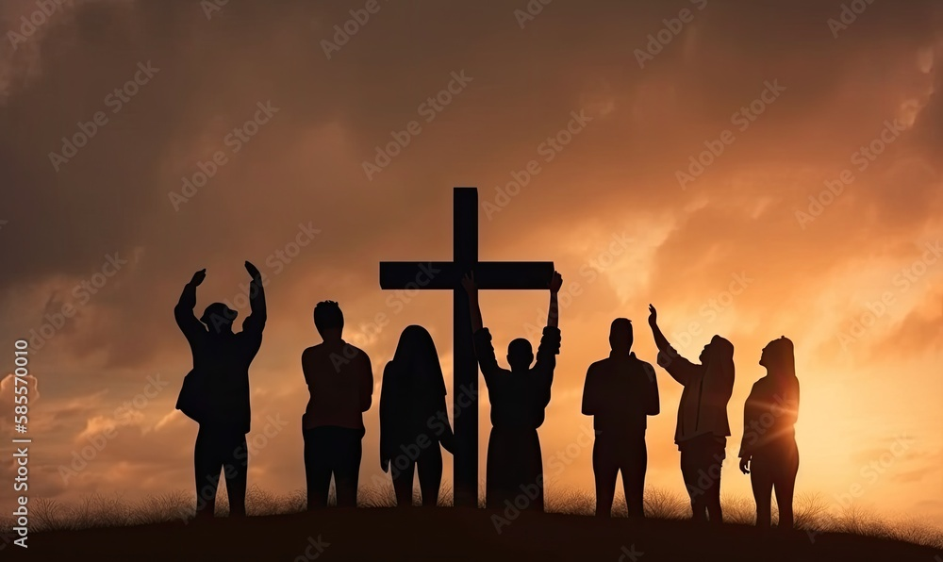
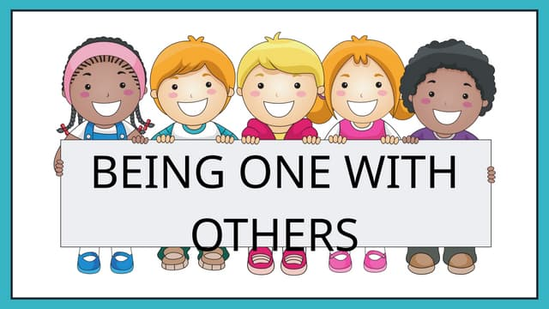
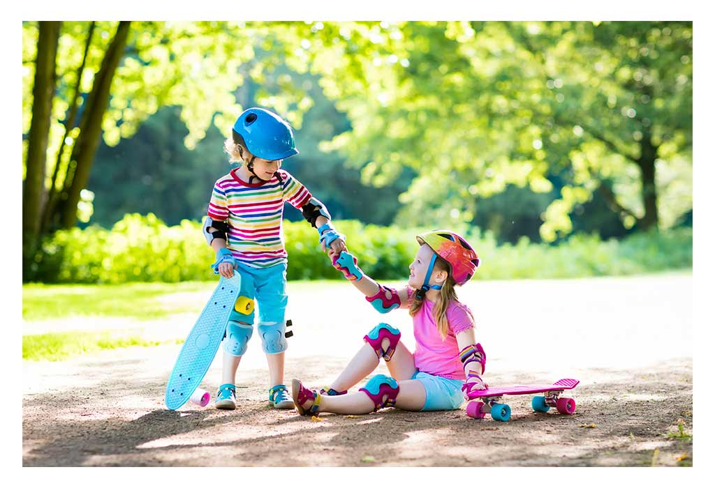

Happy UCA 49th Anniversary!
One with God/Jesus
Helping Others
Helping Creations

