Slide 1

Ballarat Central
Uniting Church
Pentecost 6
Sunday 5TH July 2026
“The Power of Choice!”
HOLY COMMUNION

Slide 2

PROCLAMATION OF THE WORD
The Power of Choice!

Slide 3
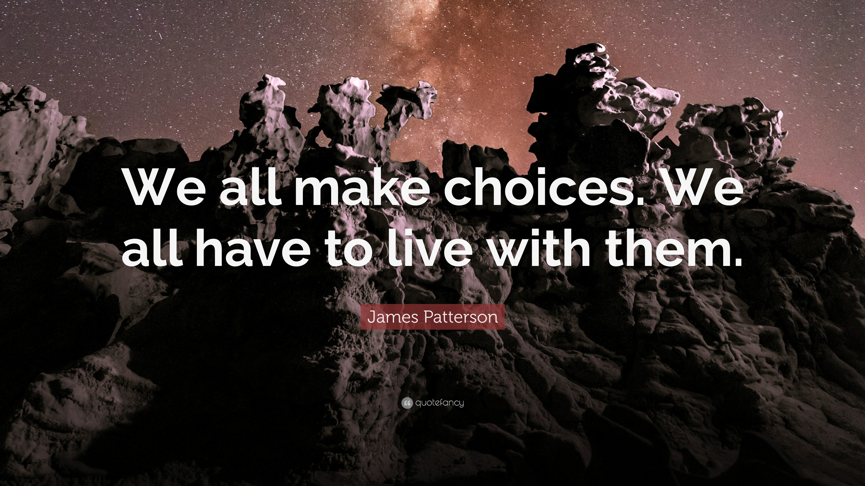
We are given the freedom to choose!
Choices have power – To make/break us!

Slide 4

CHOICE - Urgency
CHOICE – Make/Decision
CHOICE - Importance
How do we make choices? Factors we consider? Who/What we consult? Etc.
CHOICE - Relevance
Rejoice or Regret etc
CHOICE - Cost

Slide 5
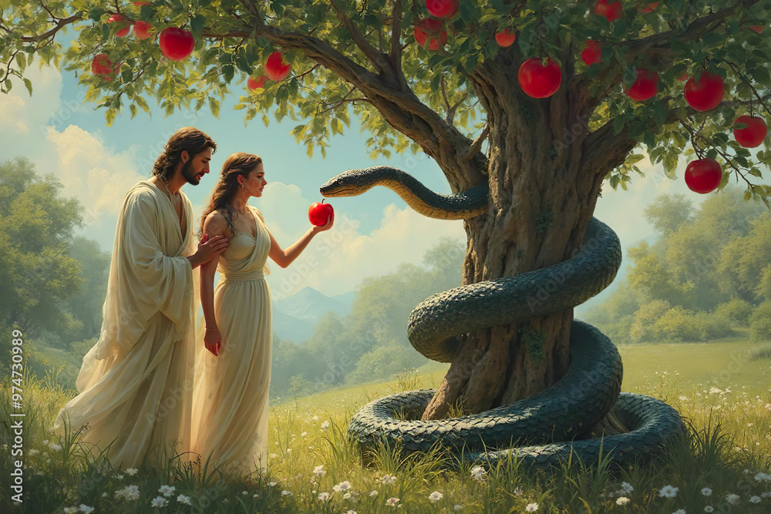
CREATION: God gave humans choices!

Slide 6
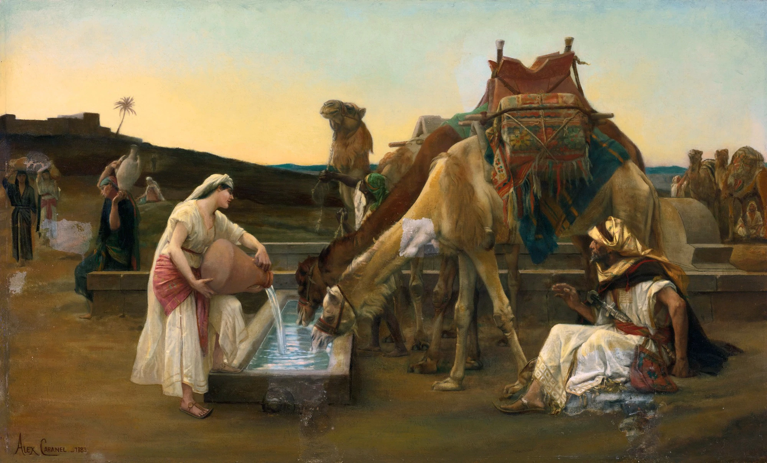
Rebekah chose to follow
Eliezer chose to consult and involve God
Choices are made for others - Isaac!
Servant/Eliezer and Rebekah – Choices!

Slide 7

We have a choice - GOD!
The Best Choice! Eternal Choice!
²⁸ “Come to me, all you who are weary and are carrying heavy burdens, and I will give you rest. (Matthew 11:28)

Slide 8
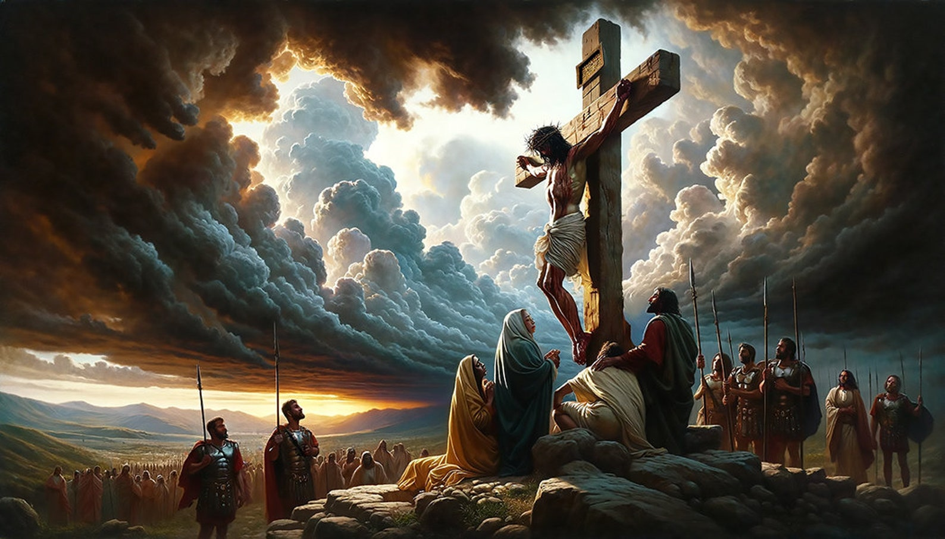
We live and work in that God’s choice!
May BCUC continues to make the right choices!
Choices that give powers!
The choices we make influence ourselves and others – Today/Future!

