Slide 1

Ballarat Central
Uniting Church
Pentecost 5
Sunday 28th June 2026
“OFFERING HOSPITALITY: Even a cup of
cold water!”

Slide 2

PROCLAMATION OF THE WORD
OFFERING HOSPITALITY:
Even a cup of cold water!

Slide 3
Hospitality is the art of making others feel welcomed, valued, and cared for, often leaving a lasting impression.
“True hospitality consists of giving the best of yourself to your guests.” – Eleanor Roosevelt (wife of Franklin)
“People will forget what you said, forget what you did, but they will never forget how you made them feel.” – Maya Angelou (USA poet, singer, activist …)
A smile is the best welcome a guest can receive.” – Grace White (USA fitness & social media influencer)

Slide 4
Romans 6:12 (NRSVUE)
¹² Therefore do not let sin reign in your mortal bodies, so that you obey their desires.
Do not offer Hospitality to Sin?

Slide 5
¹⁴ For sin will have no dominion over you, since you are not under law but under grace.
Slaves of Righteousness
¹⁶ Do you not know that, if you present yourselves to anyone as obedient slaves, you are slaves of the one whom you obey, either of sin, which leads to death or of obedience, which leads to righteousness?
Offer Hospitality to Righteousness?

Slide 6
Matthew 10:40-42 (NRSVUE)
Rewards
⁴⁰ “Whoever welcomes you welcomes me, and whoever welcomes me welcomes the one who sent me.
Offer Hospitality to God/Disciples!

Slide 7
⁴¹ Whoever welcomes a prophet in the name of a prophet will receive a prophet’s reward, and whoever welcomes a righteous person in the name of a righteous person will receive the reward of the righteous,
Offer Hospitality to Prophets/Saints!

Slide 8
⁴² and whoever gives even a cup of cold water to one of these little ones in the name of a disciple—truly I tell you, none of these will lose their reward.”
Offer Hospitality to All People!
Offer Hospitality to Little Ones!

Slide 9
In Jesus' time, the value of a cup of water
symbolizes basic hospitality and care, reflecting
the cultural practice of offering water to
travelers as a necessary act of kindness.
This act emphasizes that even the smallest acts
of kindness, such as giving a cup of water
to a disciple, are rewarded by God, highlighting
the importance of serving others without
expecting recognition or reward.

Slide 10
The cup of water represents a humble gesture
that can make a significant difference in the
lives of those in need, illustrating the broader
biblical theme of servanthood and the value of acts of kindness.
Offering what we have and afford!
Offering simple hospitality
– water … - “Renewable!”

Slide 11
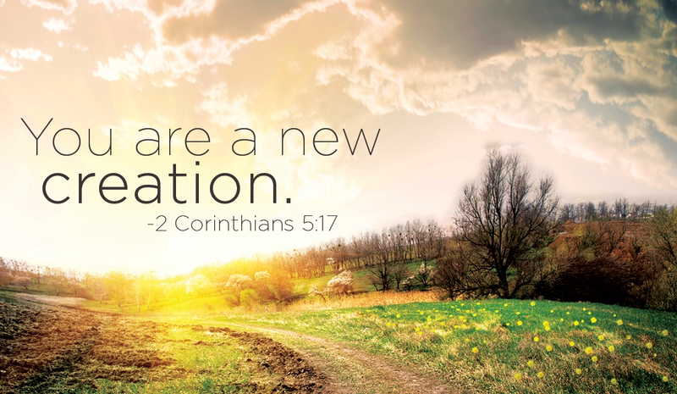
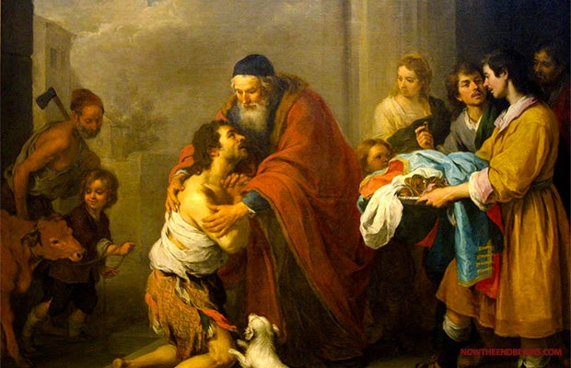
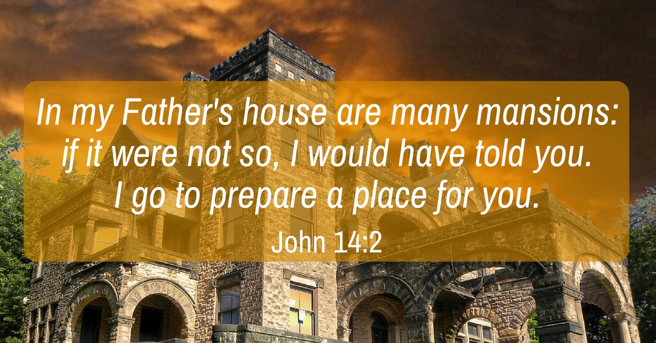
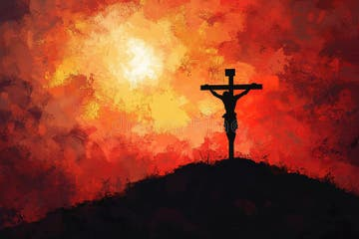
GOD’S HOSPITALITY - Abundance

Slide 12
BCUC HOSPITALITY – Who we are?
We are a vibrant, active, inclusive Christian church, committed to following the way of Jesus, growing in our spiritual journey and serving our community and world through both the work of the congregation and Uniting Ballarat. We seek to be a community which is diverse in background, life experience, culture, age and theological outlook.

Slide 13
BCUC HOSPITALITY – Who we are?
We welcome all people and endeavour to provide a safe space for all.
We are especially committed to being in relationship and community with those who are isolated, ostracised, and disadvantaged by social and political structures.
OFFERING HOSPITALITY – Cup of Water!

